Slide 1
MATLAB Programming Midterm One – Part One
Instructor: 黃世強 (Sai-Keung Wong)
TAs: 黃建洲, 蔡承恩, 林柏全

Slide 2
Midterm instruction
There are two sections. You must finish all of them.
1) Programming section (total 45pt)
You must implement a program to solve each problem
2) Report section (total 5pt = (1+2+2))
You must write a report to describe how you solve each problem
The approach for solving each problem must be clear and readable.
It contains a structure plan and shows clearly why such approach is adopted.
Each report must contain the number of words between 80 and 120 words in English. The marking scheme of the report is based on the correctness and clarity of the description of the approach. If you use fewer words to describe the approach, your score may be deducted.

Slide 3
Content
There are 3 questions. You must answer all of them.
Each program must be interactive. Deduct 5pt if the program is too slow to run.
For each question, if your program crashes, the score is zero.

Slide 4
About demo video
A demo video may have bugs. The demo video shows roughly the results. These results may not be exactly the same as the requirements. They are for your own reference. You must follow the instruction to finish your programs.

Slide 5
Program file name format
Write all your programs in a folder. The folder name is mat_MT01_P1_ID. For example, if your student ID is 12345678, the folder name is
mat_MT01_P1_12345678 // folder name
Zip the folder and upload it.
Write a program for each problem in one file.
The file name is m01_X_yourStudentID.m, where X is the problem number.
For example, if your student ID is 12345678 and the problem number is 3, then the file name must be m01_3_12345678.m.
You must not output all the intermediate results.
Output the results that are required only.

Slide 6
File content header
At the top of the file, write down your name, ID, email address, department, and date.
%%%%%%%%%%%%%%%%%%%%%%%%%%%
% Midterm Number: …
% Problem number: …
% Student Name: …
% Student ID: …
% Email address: …
% Department:
% Date: ….
%%%%%%%%%%%%%%%%%%%%%%%%%%%%

Slide 7
File content
For each problem, display the problem number before showing the results.
close all; clear; clc; % close all windows
% clear variables, and clear screen
disp('Midterm Problem 1.1') % show Midterm Problem 1.1

Slide 8
(15 pts) Midterm Problem 1.1
Write a program to ask for inputs. Then it plots a function y = f(x).
*: multiplication operator. e is the base of the natural logarithm. The process is as follows.
Clear the screen. Close all figures. Show your student ID and name. If you do not show this, your score is zero.
[2pt] Ask to input a and b as an array, i.e., ‘Please input [a b]’. For example, if a = 1, b = 0.5, then must input [ 1 0.5 ].
[2pt] If a and b are both zero, show a message “Thanks for playing” and then terminate the program (use return). Otherwise go to step 4 (i.e., a!=0 or b!=0).
[1pt] Ask to input the step size, dx, of x. if dx is zero, set it to a default value 0.25. if dx <0, show ‘dx must be a non-negative number’ and repeat Step 4. dx must be a positive number.
[8pt] Plot y versus x. x is inside [-1, 1]. The step size of x is dx. The line width of the curve is set to 5. Set the font size to 30. Call “hold on” so that more functions can be plotted in the same figure.
[1%] Set the figure on top by calling figure(1) after a curve is drawn. So that the figure window is displayed on top of all the MATLAB window(s).
[1%] Go to step 2.
The function y(x) = a * sin(5x) * cos(5x/(sin(x)+2))+ cos(10x)*e ^{-|x*x*x|/(b*b+1)}

Slide 9
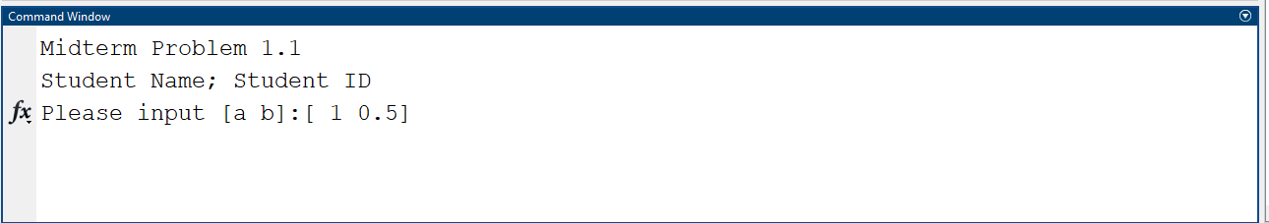
Midterm Problem 1.1
Ask to input a and b

Slide 10
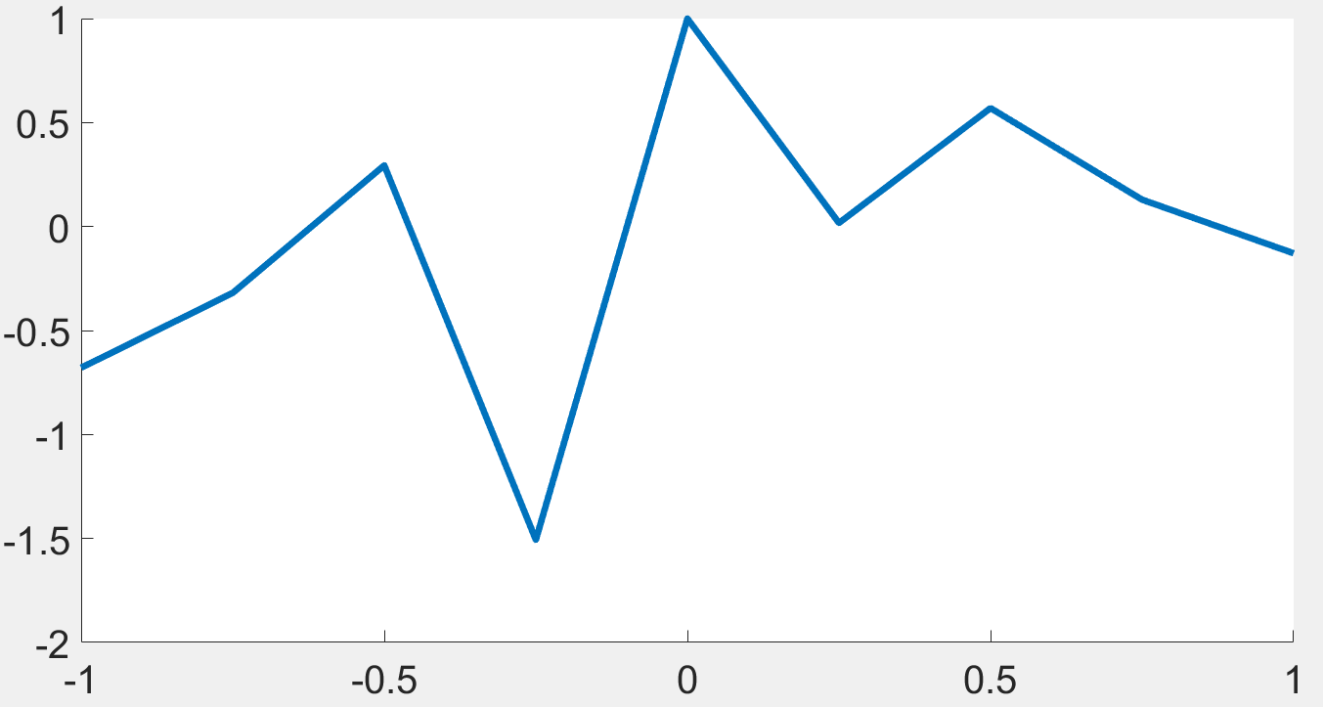
Midterm Problem 1.1
a = 1, b = 0, dx = 0.25

Slide 11
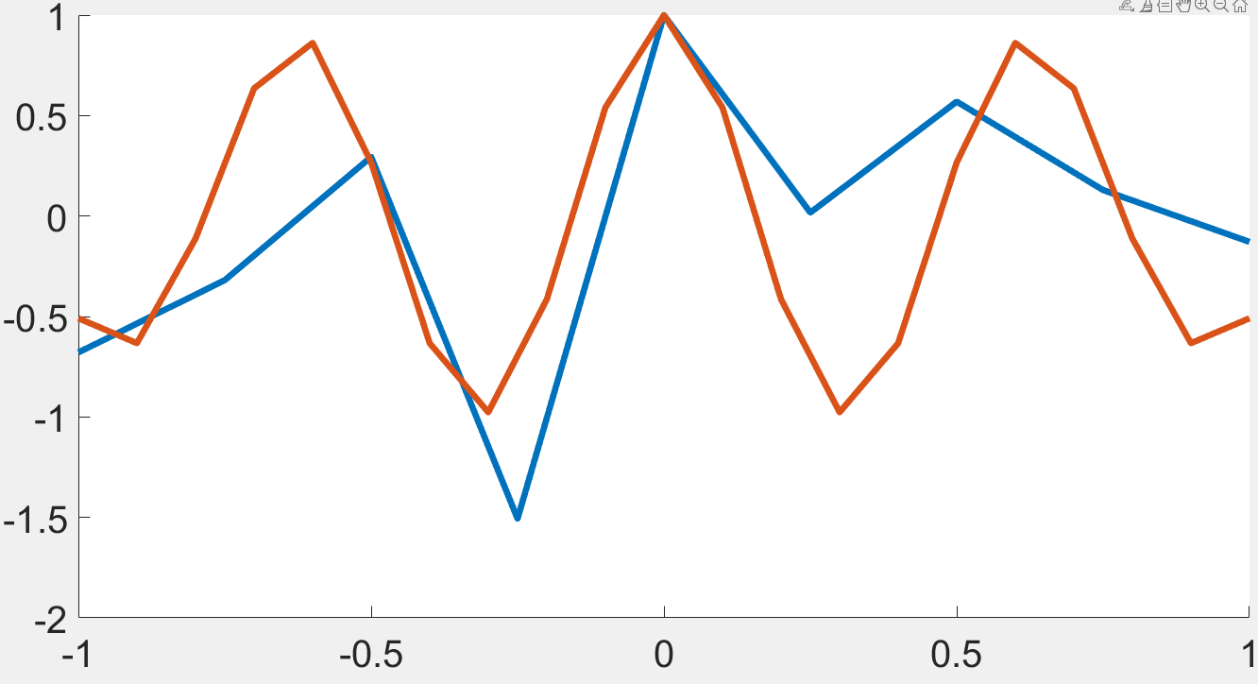
Midterm Problem 1.1
a = 1, b = 0, dx = 0.25
a = 0, b = 1, dx = 0.1

Slide 12
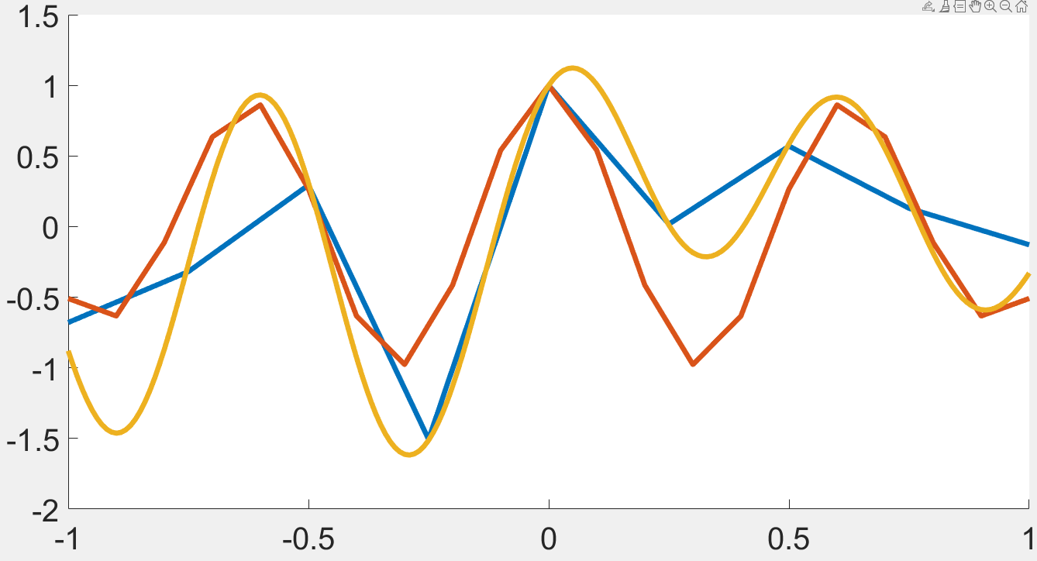
Midterm Problem 1.1
a = 1, b = 0, dx = 0.25
a = 0, b = 1, dx = 0.1
a = 1, b = 1, dx = 0.01

Slide 13
(15 pts) Midterm Problem 1.2
Write a program to ask for inputs. Then it plots curves for a family of functions. The family of functions is: x² *(1.1+tanh(cos²y)) + a * x * (y*sin (y) +2)/e^{cos(y)} – b * (3+e^{-y} cos(y)+ sin(y))= 0.
The process is stated as follows.
Clear the screen. Show your student ID and name. If you do not show this, your score is zero.
[1pt] Ask to input a. If a is smaller than or equal to 0, show a message “Thanks for playing” and then quit the program. Otherwise go to step 3.
[1pt] Ask to input an option (which is a number). If the option is 1, set d = 5 and otherwise d = 10.
Clear all curves in the current figure.
[1pt] Set the step size properly so that all the curves is smooth. The line width of the curves is 3.
[10pt] Plot curves for b inside {-5, -4, -3, …, 3, 4, 5} on the same figure. Set the font size to 30.
[1pt] Set axis( [-d d -d d] ). Call figure(1) to set the figure window on top.
Use statements similar to the right side to plot for each b value.
So that you can see the curves are plotted one by one.
8. [1pt] Go to step 2.
Hint: This is a quadratic equation of x.
plot(x1,y,'LineWidth',3);
plot(x2,y,'LineWidth',3);
figure(1);
axis([-d d -d d]);
pause(0.05);

Slide 14
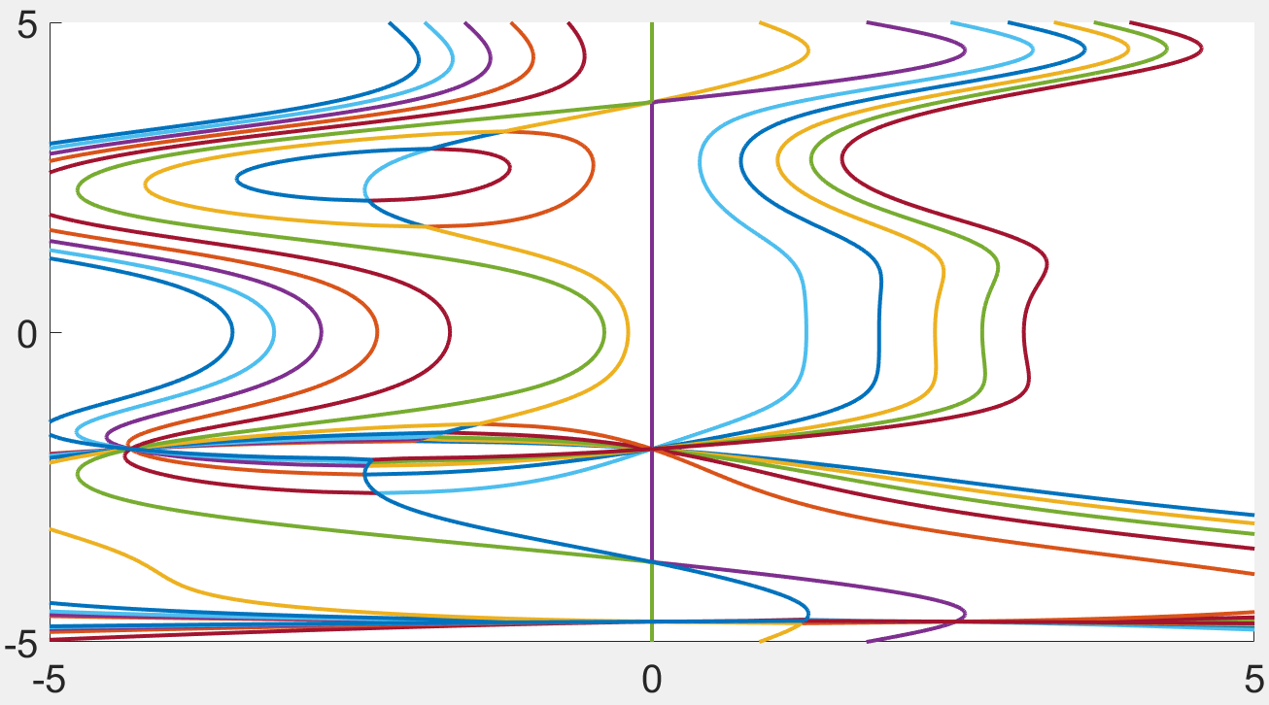
Midterm Problem 1.2
a = 1
First option

Slide 15
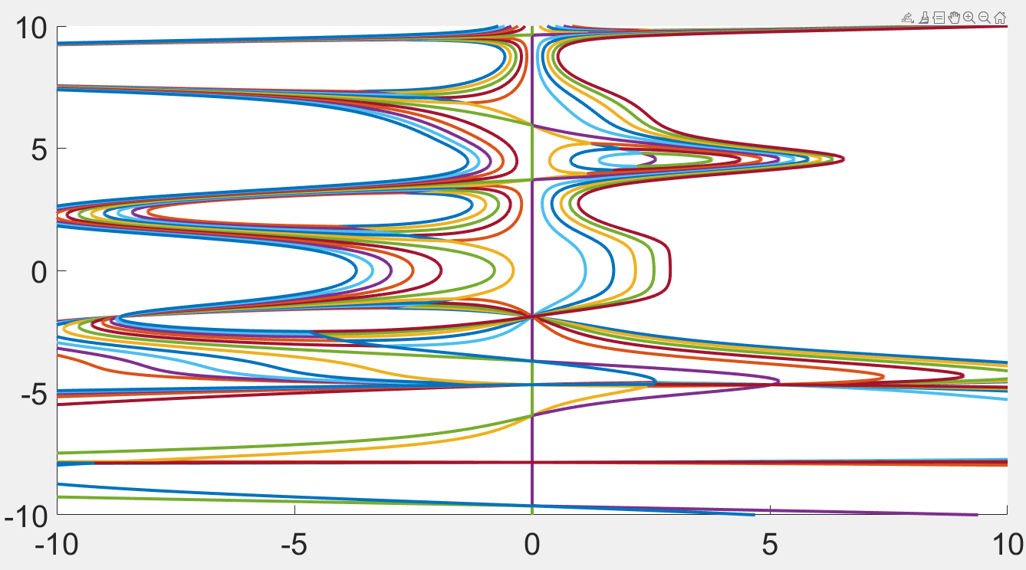
Midterm Problem 1.2
a = 2
Second option

Slide 16
(15 pts) Midterm Problem 1.3
Write a program to ask for inputs. Then it plots function z1 = f(x) and a family of function z2 = z2(x,n).
z1(x) = cos(5x) cosh(x)
z2(x,n)=[1+(-1)¹(5x)^{2*1}/(2)!+(-1)²(5x)^{2*2}/(2*2)!+...+(-1)^{n} (5x)^{2n}/(2n)!]
*[1+ x^{2*1}/(2)!+ x^{2*2}/(2*2)!+...+ x^{2n}/(2n)!]
Clear the screen. Show your student ID and name. If you do not show this, your score is zero.
Clear all the figures.
[0.5pt] Ask to input N inside [0,10]. MUST check if the input is valid. If N is zero, show a message “Thanks for playing” and then quit the program.
[0.5pt] Ask to input an option. Display the message 'Please input option: 1) All Curves 2) One Curve'
[11pt] Clear all curves in the current figure. In the same figure, if option is 1, plot z1’s curve and z2’s curves for all 0 <=n <= N. If option is 2, set n = N and plot z2 for one curve.
[1pt] The interval of y is [-10 10]. The interval of x is [-3, 3]. The step size of x is 0.02.
[0.5pt] The line width is set to 7 for curve z1. The color is [0.8500 0.3250 0.0980].
[0.5pt] The line width is set to 3 for curves of z2.
[0.5pt] After a curve is drawn, set the figure window on top. Also, call the statements on the right to see an animation. Pause is used when option is 1.
[0.5pt] Go to step 2.
axis([-3 3 -10 10]);
figure(1);
pause(0.2);

Slide 17
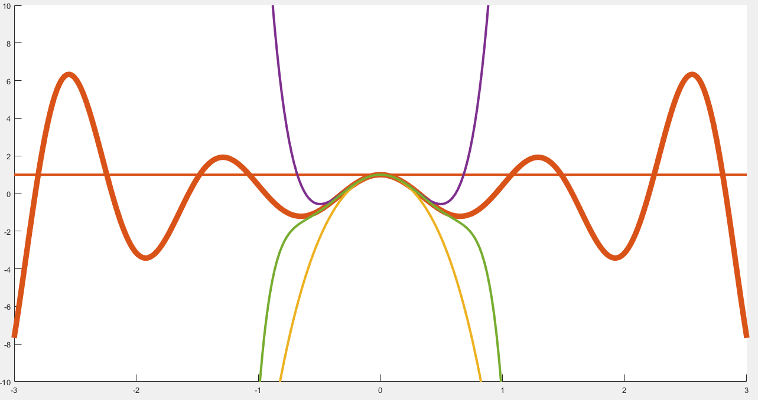
Midterm Problem 1.3
N = 3
Option = 1

Slide 18
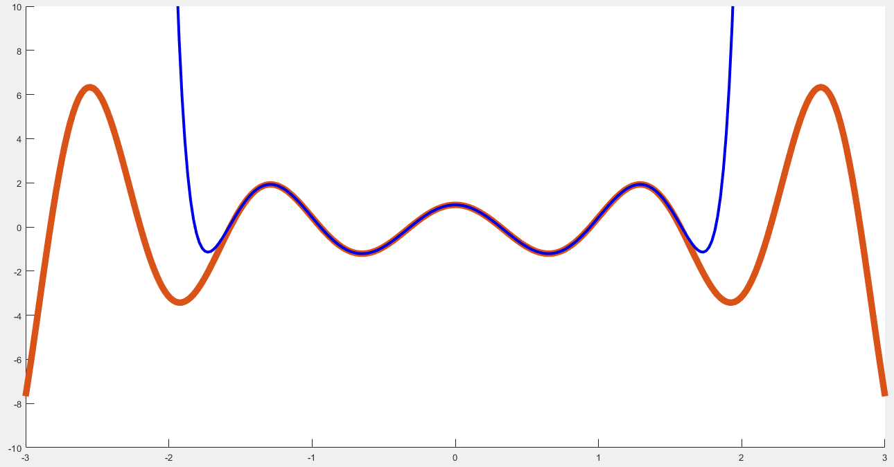
Midterm Problem 1.3
N = 15
Option = 2

Slide 19
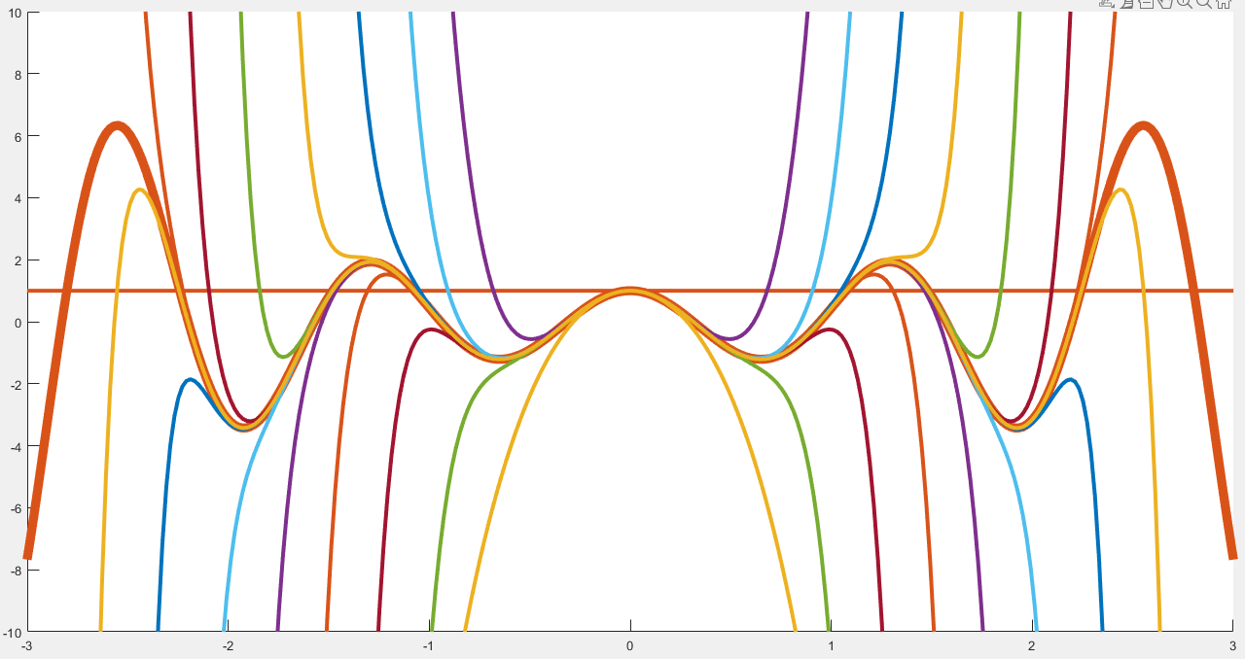
Midterm Problem 1.3
N = 15
Option = 1

Slide 20
End
Enjoy MATLAB Programming.

